Slide 1
Commercial Acumen – 1st 30 day challenge
A worked example and Challenge Tool.

Slide 2
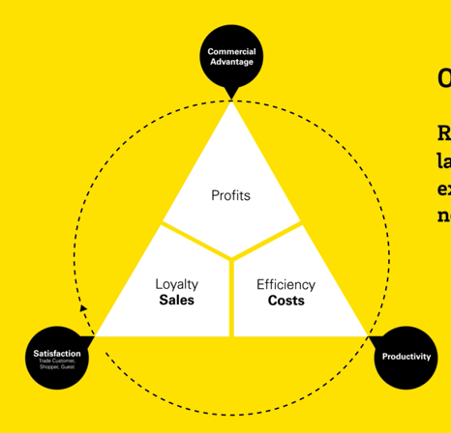
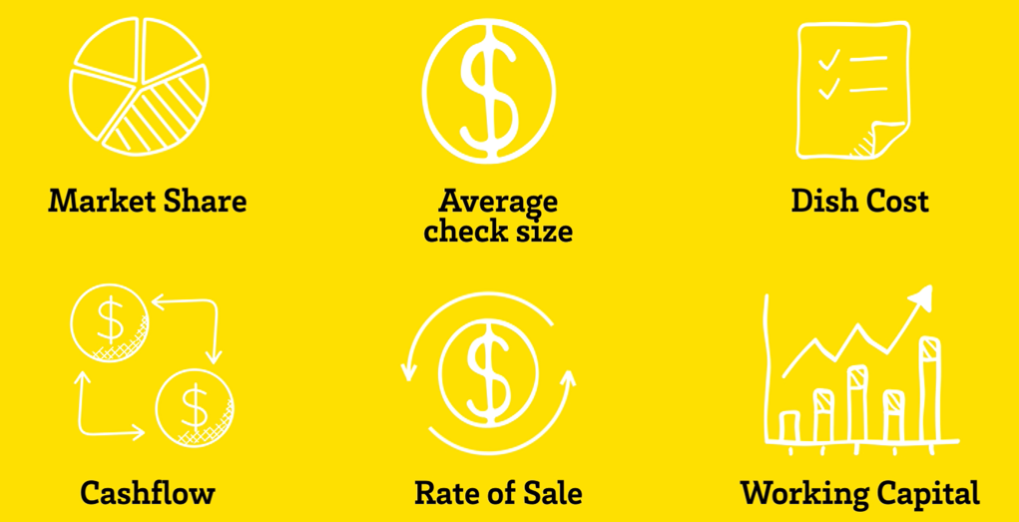
Customer
Commercial Challenges
 | Growth | Efficiency | Engagement
Business/Corporate
Operational
McCain’s main Customer stakeholders
Metrics that Matter to the Customer (Corporately)
The big commercial stuff that the customer is working on in THEIR business allocated to whether it’s supporting growth (sales revenue), efficiency (reducing their business costs) or engagement (their corporate social responsibility).
Financial Snapshot
Financial Headlines
(trends &/or numbers)
Sales, Costs, Profits
Connects back to our core model
How the big commercial stuff filters down in the customer to their store,
outlet, depot operations.
Strategy Priorities driving the commercial challenge
How the big commercial stuff filters down to what our key contacts are being asked to focus on (and therefore what might land on McCain).
The big stuff the customer is looking to achieve as a business
(this will impact on what your customer contacts are asked to achieve).
The main metrics/kpi’s the customer is looking to influence.
E.G.

Slide 3
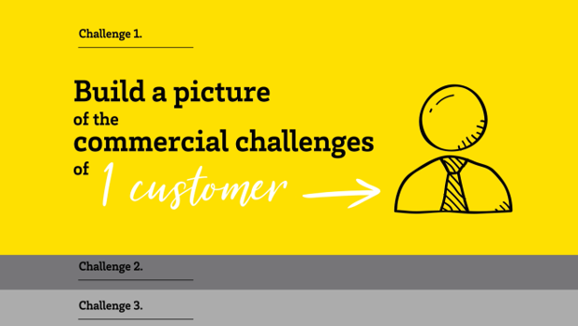
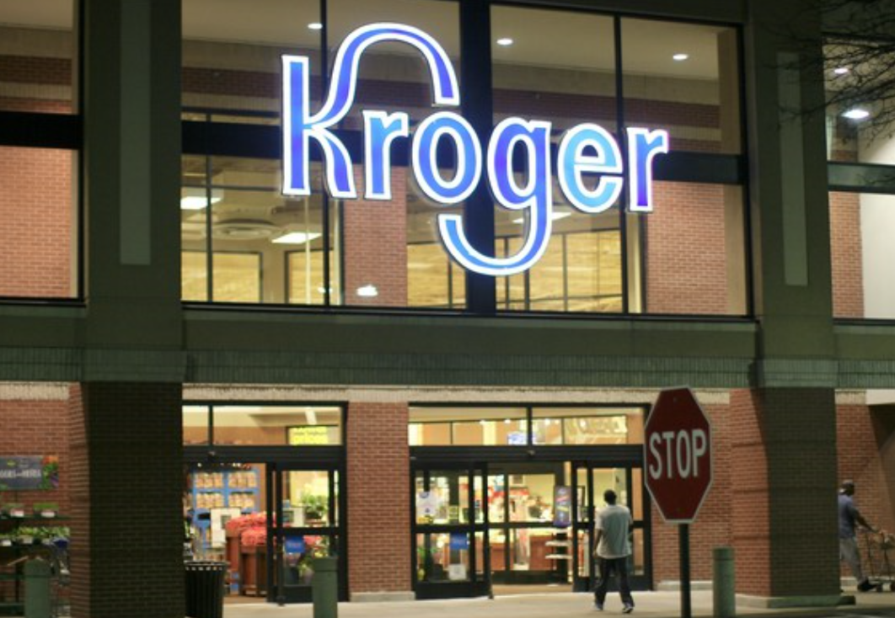
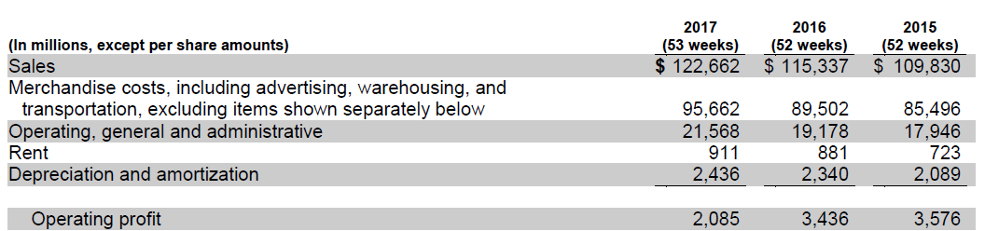
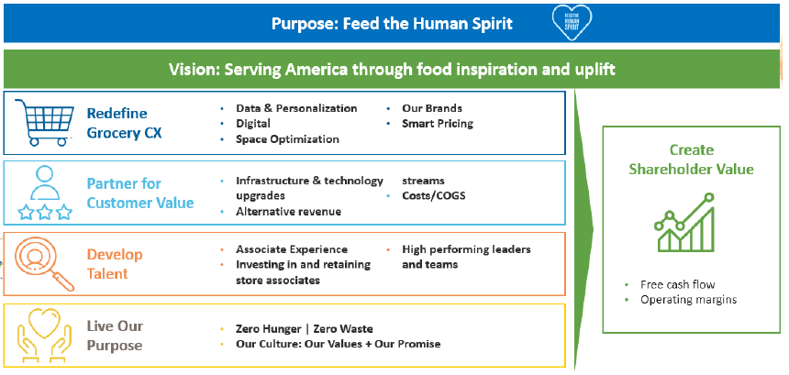
Commercial Challenges
 | Growth | Efficiency | Engagement
Business/Corporate | Year on year gains in market share. Restock Kroger: Redefine the Grocery Experience to generate $400m in profit (next 3 years). Winning in e-commerce (stop losses to Amazon). Monetizing services/products e.g. Kroger Precision Marketing or Turkey Hill Ice Cream as a revenue stream. Offset declines in petrol/fuel price changes with Grocery sales. Expand Restaurant concepts (penetrate more eating occasions). | Eliminate waste by 2025. Manage cost reductions through “Make or Buy” decisions. Cost efficiently expand partnerships e.g. Ocado. Improve cost to serve primarily through stores. | Improve the environmental footprint. Deliver Responsible Sourcing targets by 2020. Support to operationalise eating trends and make accessible e.g. Meal Kits. Support corporate CSR initiatives like Zero Hunger, Help for Heroes.
Operational | Increases like for like store sales. | Eliminating increased warehousing, transportation and shrink costs. Reducing store operating costs.
McCain’s main Customer stakeholders | Growing category share. Increase frozen average basket spend. Generate supplier income for Precision Marketing. | Reducing frozen/chilled operational costs. Improve on shelf availability from x to y. | Contributing to the corporate environmental agenda.
Metrics that Matter to the Customer (Corporately) | LFL store growth excl. petrol (+0.9% in 2017). Digital revenue (+90% in 2017). | Product cost deflation (+0.8% in 2017). Managing operating, general and admin costs (increased per $ sold n 2017). | Shopper satisfaction scores (stores/e-comm). Guest satisfaction (restaurant concepts).
 | Free cash flow (as an investment fund – doubled to $800m in 2017). Shareholder dividends. Gross margin (declined in 2017 because of increased investment in price). Improvements in operating margin. On shelf availability.
Financial Snapshot
Summary: Increases in costs outpacing sales growth which is negatively impacting operating profit
THEREFORE .. Likely to want to maintain sales growth BUT get more efficient to recover profit.
Strategy Priorities driving the commercial challenge

Slide 4
Customer:
Commercial Challenges
 | Growth | Efficiency | Engagement
Business/Corporate
Operational
McCain’s main Customer stakeholders
Metrics that Matter to the Customer (Corporately)
Financial Snapshot
Summary:
Strategy Priorities driving the commercial challenge

