Slide 1
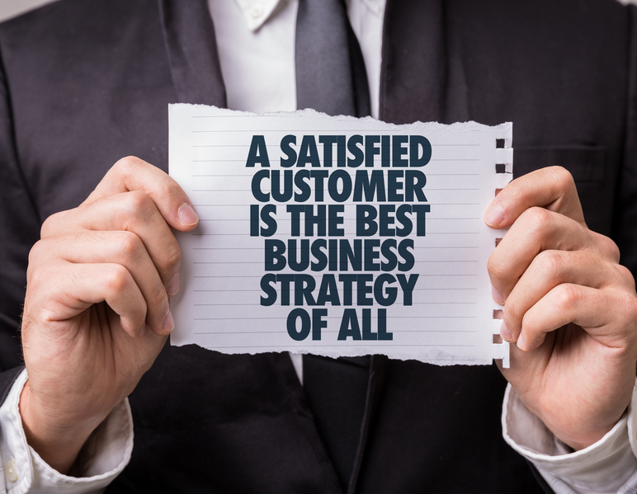

Evolving Customer Leadership from
Good to Great
Sales Leaders Toolkit

Slide 2
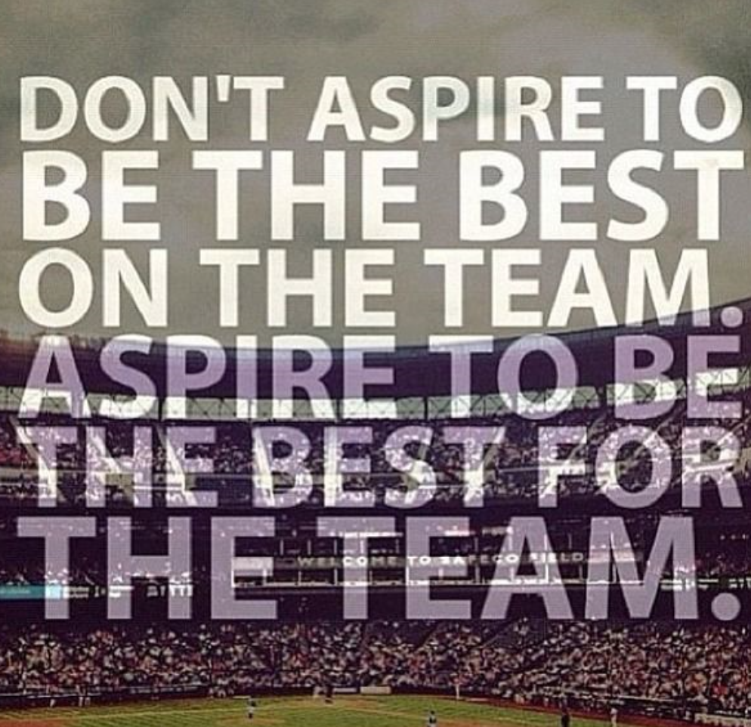
How to use this material with your team
This is a short deck for you to use with your team as you launch The McCain Way to winning with customers and the #BeMore journey. It compliments the film asset and allows you to add some depth and tailoring of the key messages so that your team understand the relevance to THEIR customers and to THEM personally as Customer Leaders. Many of the slides will be familiar given your involvement in the journey to date. The magic will come in YOUR tailoring of messages, choice of examples to be audience relevant and making it an interactive session (which the Speaker Notes support).
The Speaker Notes include:
  “Open” questions (OQ’s) to ask your team so you can spark discussion and peer learning.
  Suggestions on where you need to verbally add in your own examples for your channel/customers.
Suggested printing
  To add texture and act as a continuous reminder of the key models being introduced please consider getting Slides 9, 10, 11, 13 printed as posters so that they can be referred to easily by you AND start to become familiar to your teams.
Anticipating possible questions
  On the following slide are the typical questions that get asked at the launch of a commercial change journey like this one. Against each question we have provided some suggested responses.
  If there are any questions that crop up repeatedly please let Jamie know so that we can capture for future roll outs.
#BeMore

Slide 3
Anticipating the questions from your teams
Possible questions | Suggested response
Are these skills the same as/covered in the Success Frameworks? | The breadth and depth of skills we’re developing are aligned to the Success Framework Technical Competencies. They have been designed to future-proof our commercial capability.
How does this fit with Personal Development Plans? | This curriculum now provides the solution to meet your commercial development priorities.
How will we be trained/get access to training? | Training will take different forms and use multi-media to reflect how we all learn today. Who’s reached out to You Tube to figure out how to do something?
Is product training part of this curriculum? | Great product knowledge is a basic that we have to do brilliantly. Access to product training will continue to be on Spark U and live 101 sessions.
What’s the connection with GFSEP/RAP/McSEP and our Operating Frameworks? | This is both aligned and complimentary to our Operating Frameworks. It supports GFSEP/RAP/McSEP Modules 3 and 4.
Will completing this be part of my kpi’s? | The overall #BeMore initiative has kpi’s. Given the leader led focus, the Sales Leaders have associated kpi’s.
Is this a US or Global programme? | It’s been initiated by the US. Is being built in and for the US with input from the Sales Leaders. The intention is to go Global.
Can we use this with our Brokers? | The curriculum has been built for McCain. MSS can continue to be shared with Brokers to deliver the McCain experience to customers.
When are we expected to make time to do this? | Learning will be accessible for you to do in different environments, moments and at your moment of need.
Will other functions be exposed to this? | Marketing are part of the target audience so that the step up is made as one commercial team.
“
“
#BeMore
#BeMore

Slide 4
Evolving customer leadership from good to great.
#BeMore

Slide 5
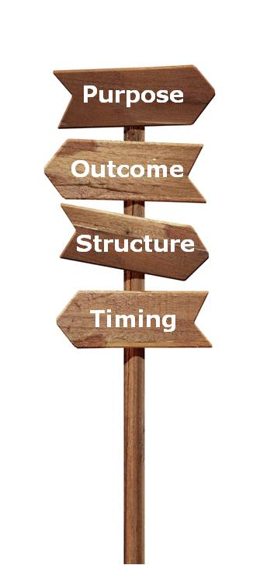
To build your understanding of the role of the Customer Leader and how you will be supported to deepen, strengthen and broaden a relevant commercial skill set.
As individuals and a team we understand are committed to learning and adapting what we do and how we do it to meet the changing needs of our customers.
A blend of media, input and discussion.
30-45 minutes.
#BeMore
Notes:
Speaker Notes
Today is another building block in our evolution from “good to great Customer Leadership”.

Slide 6

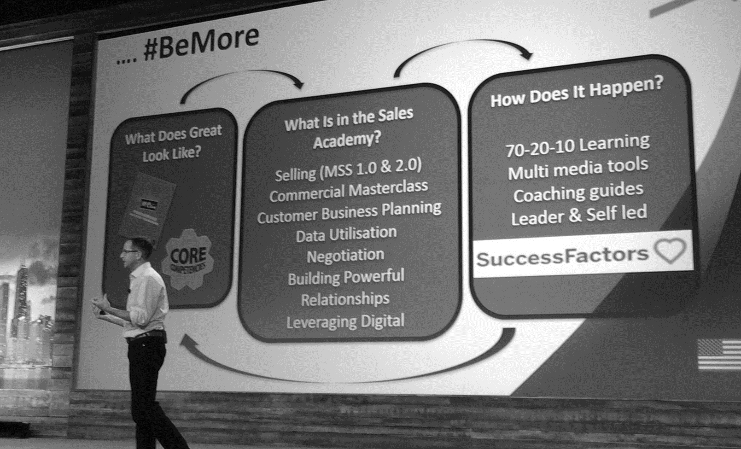
Back to the future
#BeMore
#BeMore
Notes:
Speaker Notes
Back to Vegas in May. Patrick Davis and Jamie Lamb took to the stage …
OQ: What can you remember that’s NOT in the picture (!) about the content and messages in their session?
Facilitate the discussion … you’re looking for comments like (feel free to prompt their thinking)
Sporting “greats” and what made them great.
Going to great as customer leaders means having smarter business conversations across more levers (sales and costs).
Bringing more value to customer relationships.
Data/information supports conversations (BOLT, Tibersoft etc).
Great customer leadership looks different depending on the customer relationship (the triangle).
Support coming/develop our muscles.
#BeMore
Fix your roof whilst the sun is shining .. The time is now.
Supports McCain profitable top-line growth ambition.
Benefit for McCain, customers and us as sales people.
A funny video at the end!

Slide 7
The key messages
The principles of sporting greatness can be applied to business.
All customers want profit growth (and so does McCain).
Good to great customer leadership means having smarter business conversations.
These conversations must be relevant to customers needs and the McCain relationship.
Our core commercial skills need strengthening.
A support system was being in place.
The time is NOW!
#BeMore
#BeMore
Notes:
Speaker Notes
Talk through the key messages from the Vegas session …
The principles of sporting greatness can be applied to business incl. a passion to stay ahead, commitment, relentless practice, support network, coaching, embedded core skills, never stop learning
All customers want profit growth and have their own strategies to get it. McCain does too – the evolution of how we work with customers is in the context of our profitable top line growth ambition.
Going to great as customer leaders means having smarter business conversations across more levers than we do today (sales and costs).
Customer conversations take on different breadth/depth depending on the McCain customer relationship.
We need to develop our commercial muscles – strengthen, go deeper, broader in our skill set.
The US Sales Leadership and Global were working together to build out the support incorporating our learnings from sport.
The time is now – “Fix your roof whilst the sun is shining”. JFK. We need to get ahead.
The red thread of Thursday morning was equipping us to have smarter business conversations, adapt to our customers new realities and move from Good to Great.

Slide 8

We’re starting the journey today
#BeMore
Notes:
Speaker Notes
Going to show a film that builds out why we need to change and what that change looks like for us as Customer Leaders.
Brief is to watch and then we’ll discuss your likes and concerns about the changes we’re making before talking in more depth about what it means for us/our customers.
Play the film!
Facilitate a discussion about the team’s thoughts – their likes and concerns about the change. (Capture these and feedback to Jamie L).
OQ: What do you like about the way our role as Customer Leaders is evolving?
OQ: What concerns do you have?
… Post discussion – Let’s move in to exploring some of the key models and how they relate to our customers.

Slide 9
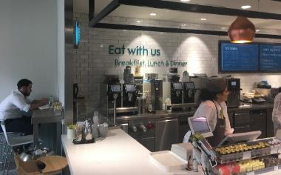
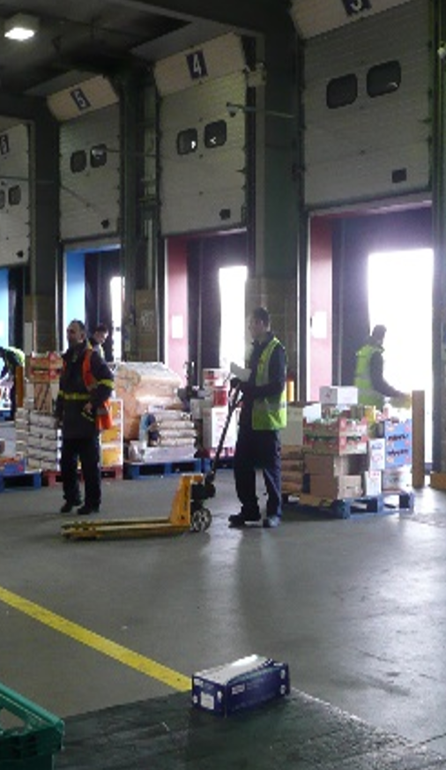


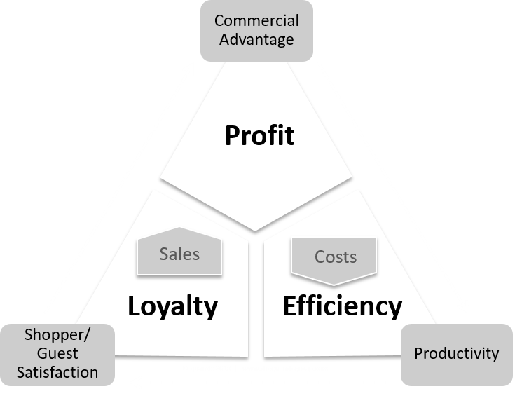
The basic model is very similar for all businesses but the solutions vary enormously
#BeMore
Notes:
Speaker Notes (Tailor these to YOUR customers/channel)
All customers are under pressure to grow their profit.
OQ: What levels of total business operating profit are they working on?
Use your own examples of customer operating profit to show how slim they are…… e.g.
How they deliver profitable growth is a function of their strategies aimed at increasing sales value/volume &/or managing their business costs.
OQ: Give me examples of strategies that our customers are deploying to a) Increase their business revenue/sales?
Use your own examples e.g.
OQ: Give me examples of strategies that our customers are deploying to better manage their costs/be more efficient?
Use your own examples e.g.
OQ: What are most of our current conversations with customers focused on? Sales or Costs?
OQ: Do we really understand what our customers strategies and metrics are across these 3 areas?
Remember: this is about moving from good to great so we need to strengthen our strengths and solve for our weaknesses.

Slide 10

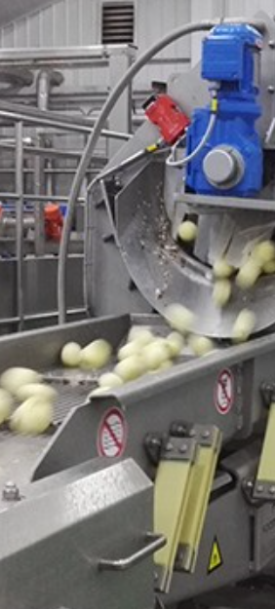

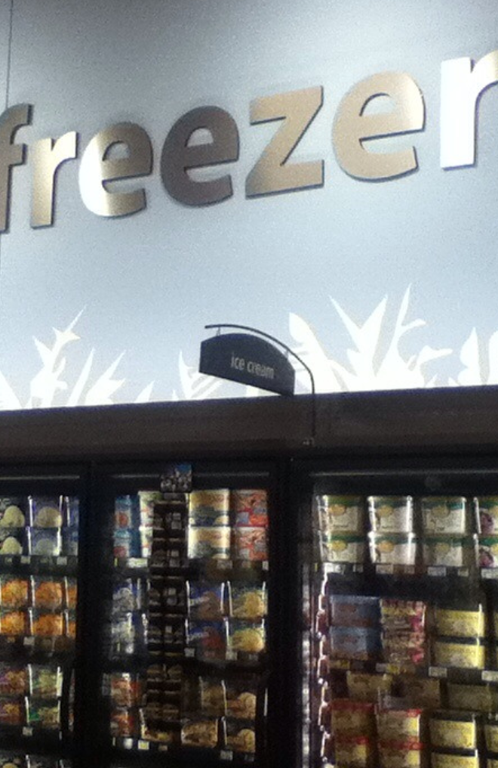
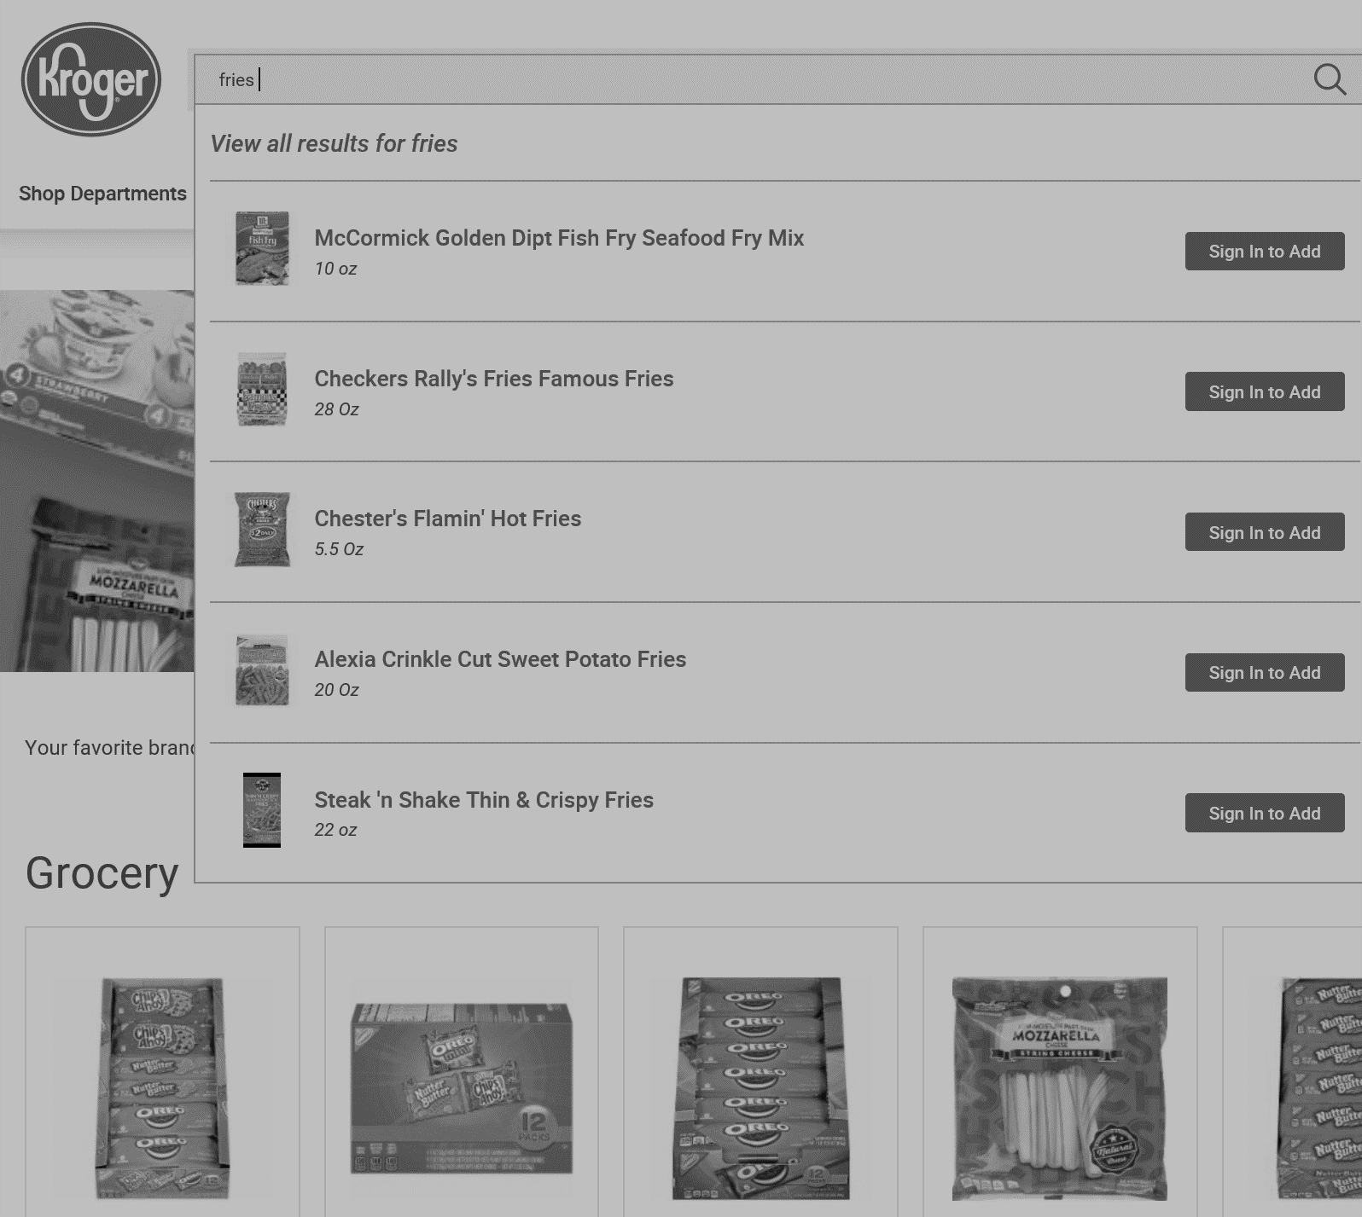
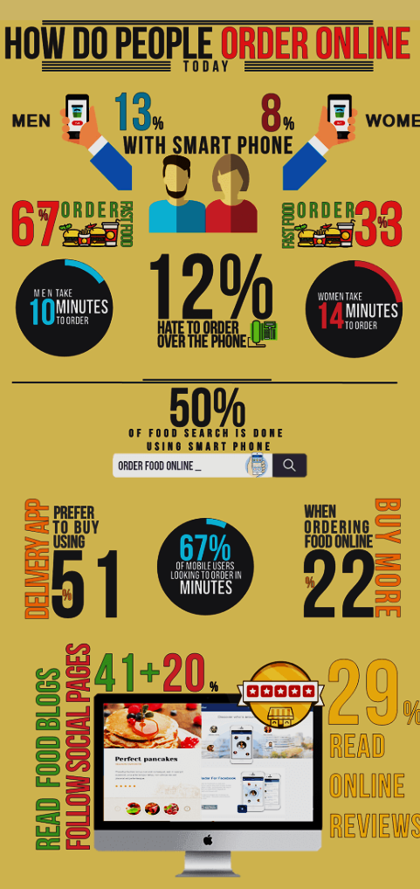
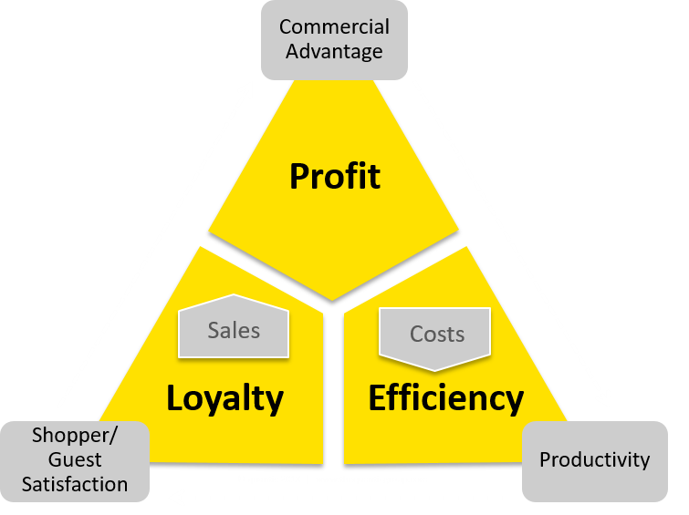
Customers want suppliers to be bringing solutions across a breadth of levers and have business, not product, conversations
Growth
Efficiency
Engagement
Sales Development
Penetration:
More customers
Frequency:
More often
Gross Margin Development
Price
Cost of goods
Cost Control
Labour efficiency
Waste and shrinkage control
Capital Equipment
Cash Management
Basket spend:
More purchases/
Up-trading
Mix
Utility costs
Repair costs
Advertising costs
Transport costs
Stock turnover
Payment terms
Inventory levels
Supplier equipment
Leased equipment
Equipment longevity
Insights and Commercial Support
Retail/RTMkt: Category development and management
Collaborative planning and forecasting
Operator: added value services/advice
Operator: demand creation
#BeMore
Notes:
Speaker Notes (Tailor these to YOUR customers/channel)
All customers want suppliers to be focussed on bring solutions that solve the customers tensions or, help them to unlock opportunities.
Use your own examples e.g.
Bringing these solutions means understanding the customers full value chain at a level deeper than Growth and Efficiency where things can be commercialised (quantified).
Use your own examples e.g.
Customers also want to work with suppliers who engage them in less or non-commercial added value. Typically this is data, information, insights.
Use your own examples e.g.
The white boxes show examples of levers that suppliers use to help customers across the full value chain.
OQ: Which ones have/are we leveraging today? How?
Data and systems will be important fuel for these conversations … PROS – Salesforce – Tibersoft – BOLT Initiatives will help inform all conversations.
OQ: Where are our opportunities to be more relevant in creating value beyond product for customers?

Slide 11
What great Customer Leadership looks like
“Helping customers to achieve THEIR objectives using mutually beneficial solutions that maximizes their profitable revenue potential to McCain”
Thought
leadership
across the
full P&L
Leads an interconnected cross functional team
Understands the customers business & P&L drivers
Co-creates a strategic 3 year customer plan for end to end value creation with joint project teams
Works with hindsight, insight & foresight
Demonstrate category leadership
Brings the voice of the customer into McCain
Building interconnected
teams
THOUGHT LEADERSHIP
Relationship
+
A balance of support across
growth + efficiency levers
Managing peer to peer relationship
Manages cross functional interface
Understands the customers business model
Develops a 12 month customer needs based plan with selected efficiency initiatives
Adapts and personalises channel marketing programmes
CONSULTATIVE
Relationship
+
Products/ Services that meet my needs from reliable brands/ suppliers
Buyer : Seller
relationship
Buyer – Seller interface
Top line understanding of how the customer works
Positions and executes against brand/ channel marketing programmes vs. generic customer needs predominantly to support growth
FUNCTIONAL
Relationship
#BeMore
Notes:
Speaker Notes (Tailor these to YOUR customers/channel)
The depth and breadth of the business conversations that customers want is a function of their scale/complexity of the customer, our relationship with them and the size of the opportunity for McCain.
These principles are omni-channel so for example, at all levels there will be a blend of channels/customers.
At each level customers have expectations of great suppliers : what, how and who with.
OQ: Where are we with the majority of our team’s customers?
Lead a discussion about this – make sure it’s a realistic view.
FYI : We’ve talked about the following:
Thought Leadership: McD Head Office/Regionals, Sysco Head Office, National Accounts (a few), Direct Chain Accounts (a few)
Consultative: National Accounts, Direct Chain Accounts, National Retailers, Large Regional Retailers, Indirects (large ones)
Functional: Indirects, Small Regional Retailers
Customers may move up/down over time – preferably this is a conscious choice by McCain.
What’s different to how we’re working with customers today?

Slide 12

Leveraging Digital with Customers
Negotiation
Building Powerful Relationships
Customer Business Planning
Commercial Acumen
Leveraging Data for
Business Opportunities
McCain Selling System 2.0 incl.
Incl. deep dives in to Questioning & Listening,
Customer Needs, Selling Stories, Handling Objections
McCain Selling System 1.0
The Year 1 skills step up needed to achieve great
#BeMore
#BeMore
Notes:
Speaker Notes
To fuel this transition from good to great Customer Leadership we have to step up, to strengthen, deepen and broaden our commercial muscles.
This means building on the foundations of The McCain Selling system 1.0 and going deeper to ensure we can ask great questions about the customers value chain, really uncover all of their needs, create tailored and commercial need-solution based selling stories and be better at handling objections so we don’t leave money on the table.
Added to this we need to bring in new skills as THE way we do things. For example,
Having consistent approaches to creating customer business plans that are centred on the customers needs
Developing our commerciality to be comfortable developing and selling end to end solutions
Using internal and external data to fuel business conversations
Strengthening our negotiation skills as the size/scale of negotiations gets bigger
Developing our Emotional Intelligence to build relationships across broader networks and functions in customers.
Working with the new core skill – Digital, from e-comm. to advising end users on Marketing themselves through on-line platforms or being part of the Delivery revolution.
This looks like a lot of learning ……

Slide 13

The schedule of learning module releases
August
Sept
Oct
Nov
Dec
Jan
Feb
March
Changing role of the Customer Leader
#BeMore
Learning Introduction
Customer Business Planning
MSS 2.0 - Deep Dive in to Customer Needs incl.
Questioning & Listening
MSS 2.0 Establish the Interest
Building Powerful Relationships
Sales Leaders as Functional Coaches
Commercial Intimacy
Leveraging Data for Business Opportunities
MSS 2.0 Explain the Solution/ Emphasise the Benefits
Negotiation
MSS 1.0
MSS 2.0 – Deep Dive in
Creating Selling Stories
MSS 2.0 Execute Next Steps/ Make Stuff Happen
#BeMore
Notes:
Speaker Notes
It is a lot of learning so it’s being phased and released as monthly episodes just like your favourite Netflix series!
This is your learning about the Changing role of the Customer Leader and the film will be available for you to access and watch at any time. The Sales Leadership team have had a session about our role in your learning and how to provide functional coaching support.
In September there will be another film explaining how you’ll be able to access YOUR #BeMore learning at YOUR moment of need, the types of learning and the support materials you’ll receive. There will also be our module on Commercial Acumen.
There after regular releases are timetabled….

Slide 14
What you will experience
Builds on the familiar but future proofed.
Multi-media learning and downloadable tools.
Accessible bite sized learning at your moment of need.
Relevant to your customers and their business needs.
Formal and informal learning moments.
Leader led upskilling and embedding.
A delivery mechanism as slick as Amazon and useful as YouTube!
#BeMore
#BeMore
Notes:
Speaker Notes
The solutions that are being developed are centered around the familiar McCain Selling System principles.
They are supported through different media that best supports the learning experience.
The #BeMore platform will mean that we can access learning and materials whenever we need them.
Content is developed to show omni-channel and channel specific relevance.
We’re evolving to learning moments and environments that are reflective of how we now learn in a blended on/off line world.
What you can expect from me is …… <insert your commitment(s) here>
AND – a user experience like those you have come to expect and use on a regular basis.

Slide 15
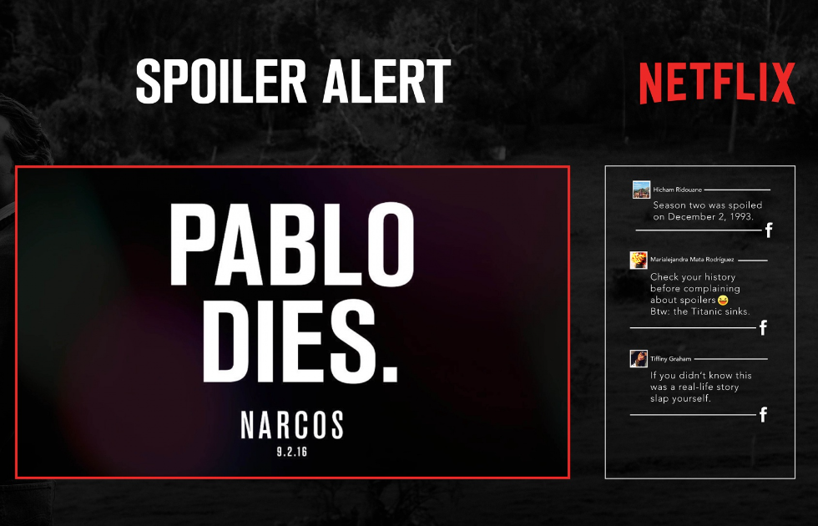
Coming to a screen near you in September …
#BeMore
#BeMore
Notes:
Speaker Notes
Coming to a screen near you …

Slide 16
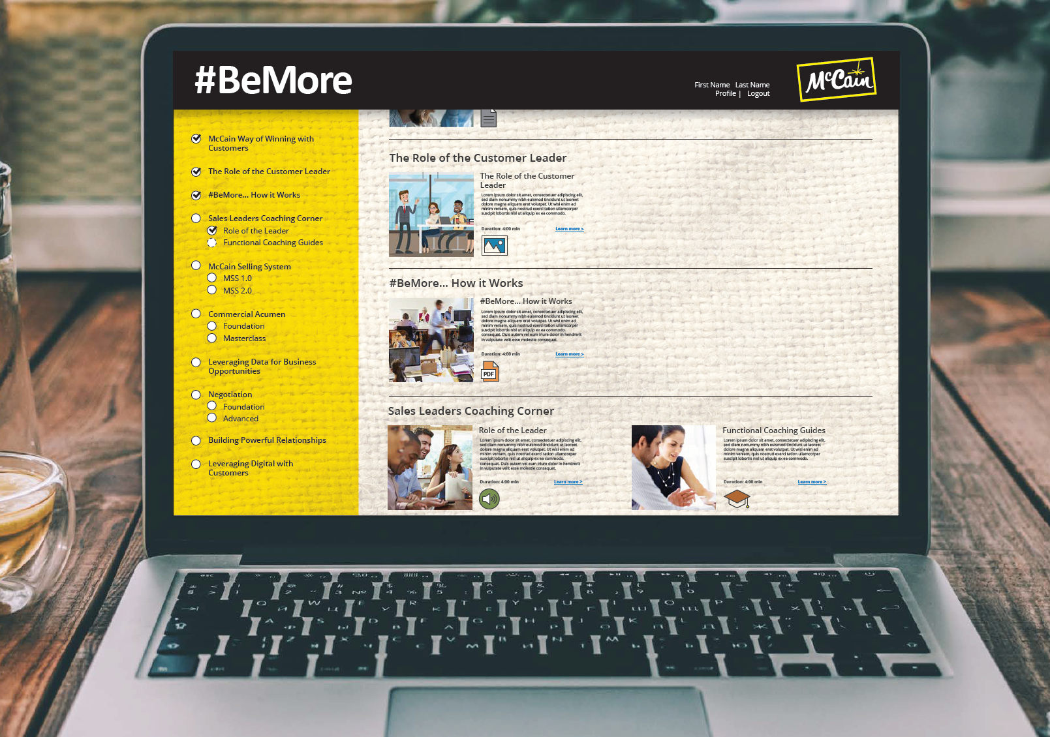
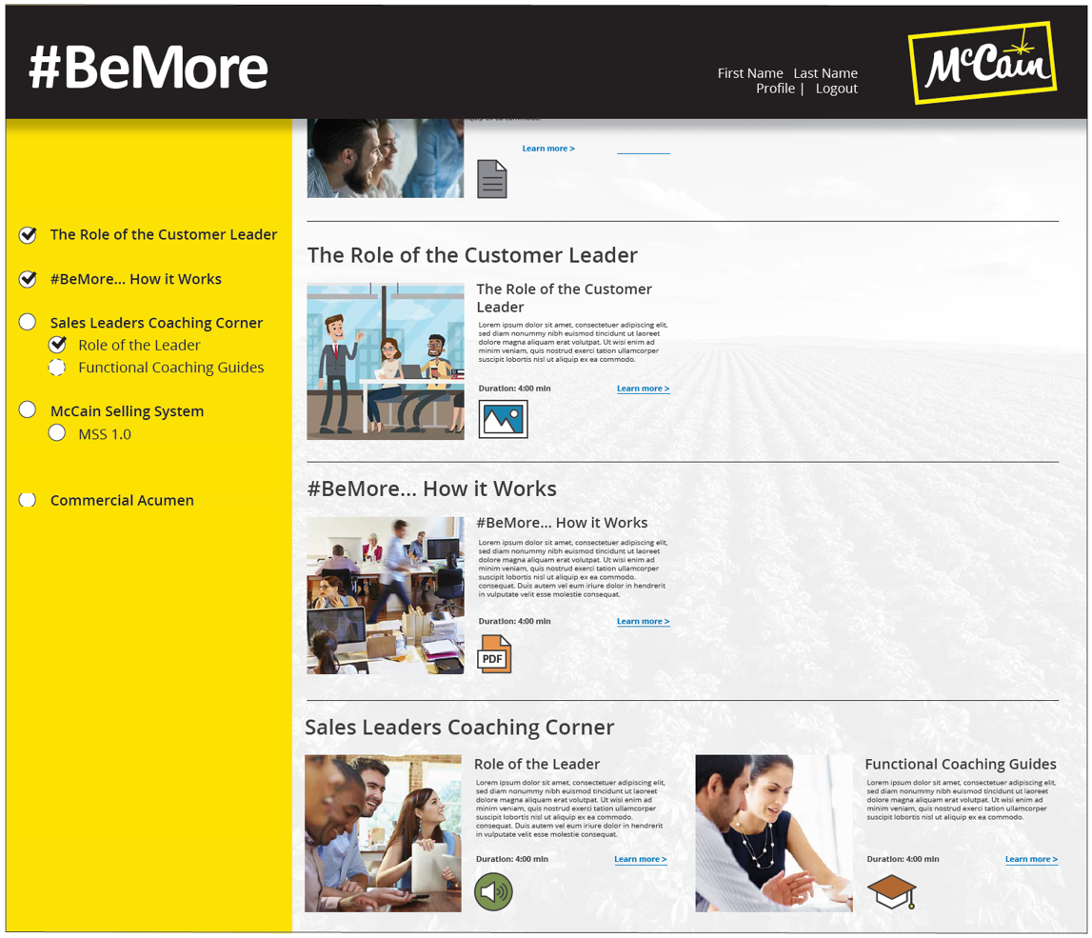
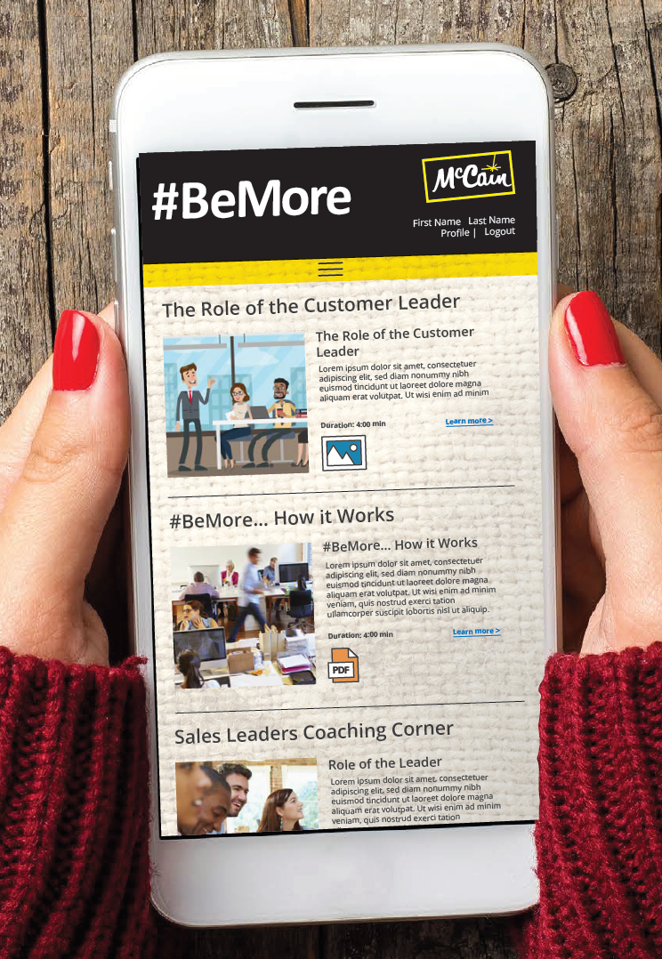
Coming to a screen near you in September …
#BeMore
Notes:
Speaker Notes
A sneak preview of the #BeMore learning platform that will be landing with us in late September ….

Slide 17
Notes:
Speaker Notes
We don’t need to wait until September though to start “#BeingMore” …..
OQ: What can we commit to start doing right away to get ahead in “BeingMore”?
Brainstorm with the team what can be done to start your team’s move from “Good to Great”.
Agree 1 commitment each person will take e.g. It might be to choose one customer, investigate their needs/tensions around efficiency and share back at your next meeting?

