Slide 1
Commercial Acumen – Challenge 1
Sales Leaders HIT.

Slide 2
The Commercial Acumen learner journey 3 x 30 days, Challenge 1
Stage 3: Team complete the challenge
Be curious, be interested in the customers business – ask, listen, search.
Build out the understanding.
Use the Buddy and Line Manager to bounce thinking off.
Capture on the Challenge Tool.
START
Stage 1: Preparation
Leader to brief
  Watch the Commercial Acumen film.
  Read the Snapshot.
  Read the Challenge 1 Brief.
  and then offline
  To capture their understanding of the commercial challenges facing 1 of their customers (NOT McCain with the customer) and bring them to the session.
Stage 4: Leader led progress check in
Socialize Challenge Tools with buddies for “likes, concerns and suggestions”.
Socialize and share as a team.
Talk through what’s worked well, things to improve on to keep the Tool up to date.
Stage 2: Leader led 30 min SKILLS HIT
Socialize preparation and foster honest discussions about how well we understand the commercial tensions of customers.
30 day challenge briefing.
Learn together.
Buddy up.
Develop a personal action plan to start and complete the 30 day challenge.
Challenge 2 ….

Slide 3

How to use this material with your team
This is a short deck for you to use with your team as you launch the first 30 day Commercial Acumen challenge and set them up for success. It compliments the film asset and allows you to add some depth and tailoring of the key messages so that your team understand the relevance to you as a TEAM, THEIR customers and to THEM personally as Customer Leaders.
Navigate your team through the learning journey.
Brief your team use the #BeMore platform to:
  Watch the Commercial Acumen film.
  Read the Snapshot.
  Read Challenge 1 brief.
  and then offline
  To informally capture their understanding of the commercial challenges facing 1 of their customers (NOT McCain with the customer) and bring them to the session.
Prepare and run your 30 min SKILLS HIT by adapting this material.
  The examples on Slides 12-19 are for you to use as you feel appropriate BUT please remember that ideas DO travel in an omni-channel world.
  Have a view on which customers might be interesting for the Challenge.
  Optional printing: Slides X, Y as handouts for reference….
  On the wall for the session .. Have 3 post its – Growth , Efficiency and Engagement.
#BeMore

Slide 4
Commercial Acumen – 1st 30 day challenge
Getting started.

Slide 5
Our Commercial Acumen journey 3 x 30 days, Challenge 1
Stage 3: Team complete the challenge
Be curious, be interested in the customers business – ask, listen, search.
Build out the understanding.
Use the Buddy and Line Manager to bounce thinking off.
Capture on the Challenge Tool.
START
Stage 1: Preparation
Leader to brief
  Watch the Commercial Acumen film.
  Read the Snapshot.
  Read the Challenge 1 Brief.
  and then offline
  To capture their understanding of the commercial challenges facing 1 of their customers (NOT McCain with the customer) and bring them to the session.
Stage 4: Leader led progress check in
Socialize Challenge Tools with buddies for “likes, concerns and suggestions”.
Socialize and share as a team.
Talk through what’s worked well, things to improve on to keep the Tool up to date.
Stage 2: Leader led 30 min SKILLS HIT
Socialize preparation and foster honest discussions about how well we understand the commercial tensions of customers.
30 day challenge briefing.
Learn together.
Buddy up.
Develop a personal action plan to start and complete the 30 day challenge.
Challenge 2 ….

Slide 6

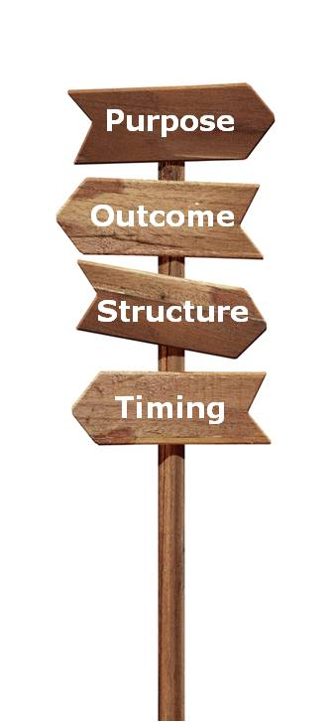
To provide a fast start to taking on and succeeding in our 1st 30 day challenge.
To provide a fast start to taking on and succeeding in our 1st 30 day challenge.
Action based.
30 minutes.
#BeMore
Notes:
Speaker Notes
Today is a building block in our evolution from “good to great Customer Leadership” – focussing on Commercial Acumen.
I asked you to watch the Commercial Acumen film but let’s watch it together as a refresher.
OQ: Why do we as a team need to further develop our Commercial Acumen muscles?

Slide 7

What commercial challenges are giving our customers a headache?
Share your first thinking.
Notes:
Speaker Notes
I asked you to think about 1 customer and THEIR commercial challenges .. Let’s talk through your thoughts.
Get each team member to share e.g. 3 commercial tensions, ask them to post it note them and stick them on the wall under the headings of Growth, Efficiency and Engagement. Rapid fire – burst of activity.
Challenge: a) are these commercial challenges the customers? (not McCain’s) b) people’s views on whether it’s Growth, Efficiency or Engagement?
OQ: Looking at what we have on the wall, what does this tell us about our understanding of our customers commercial challenges?

Slide 8
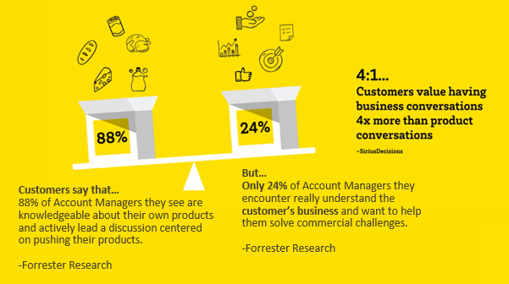
Are we part of the solution or the problem?
Notes:
Speaker Notes
We saw this in the film … OQ: most of the time, are we part of the 88% or the 24%?
OQ: What happens when we are part of the 24%? How does it make you feel? How doe it make the customer feel?
CQ: Is it in our DNA to have business, not product, conversations? If yes, challenge to validate and ask how we can step up even further.

Slide 9
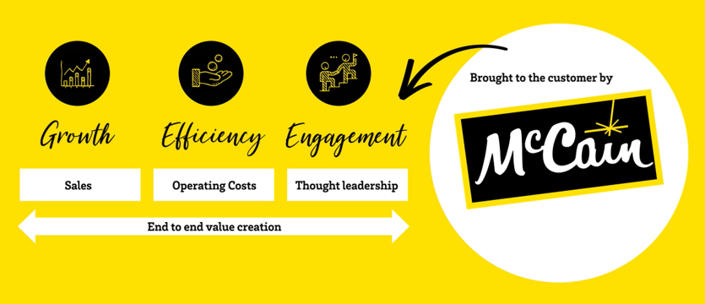
If we’re part of the solution we’re creating end to end value
Notes:
Speaker Notes
In low growth macro environments, customers want help to unlock any growth they can access but it becomes easier to improve profits by managing their costs. Think about the film and you saw some of the operating profits that our customers are achieving… they’re low. To get just $10k of operating profit if you are a Distributor or Retailer means generating a lot of revenue e.g. which is tough in the current environments .. Kroger $0.5m. Chains make a better margin and therefore need lower revenue BUT to get $10k in operating profit they’ll need to serve quite a few extra servings e.g. at an average check size of c $25 this can might mean up to c. 1,500 servings.
Customers want relevant help across all 3 of these areas – they are our “new currencies”.

Slide 10
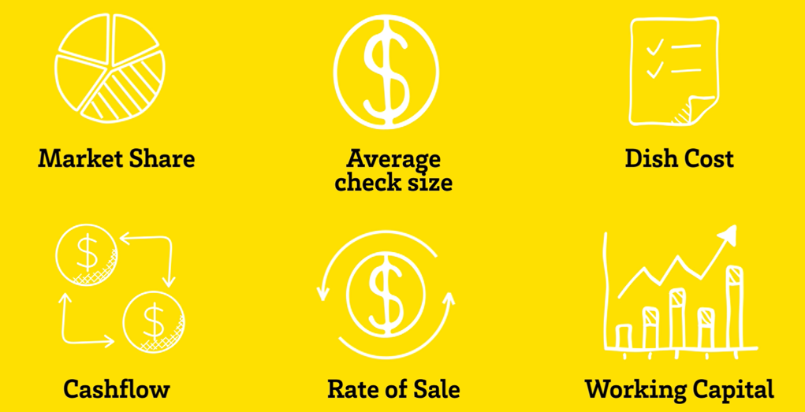
Supporting their commercial challenges impacts their metrics that matter
Notes:
Speaker Notes
Whilst we may understand some of our customer’s commercial challenges – do we understand the metrics/kpi’s that go along side these? The ones that they are trying to influence and do we talk THEIR language?
OQ: Which metrics are your customers trying to positively influence against some of their commercial challenges?
Use the wall of Growth, Efficiency, Engagement post its as a reference point and choose a few to talk through.

Slide 11
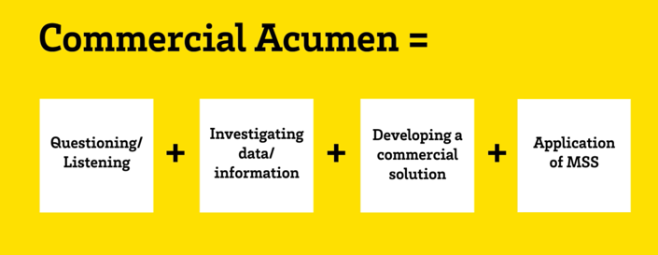
This takes Commercial Acumen
Notes:
Speaker Notes
Developing commercial acumen is a mix of logic and magic built over time. In many instances the magic comes from being commercially confident and experienced which includes learning through errors of judgement about what to commercially say or do in specific situations.
The logic is a combination of skills that need to be red threaded together so that we get the sum of the parts working together.
Our initial focus is going to be on the logic.

Slide 12
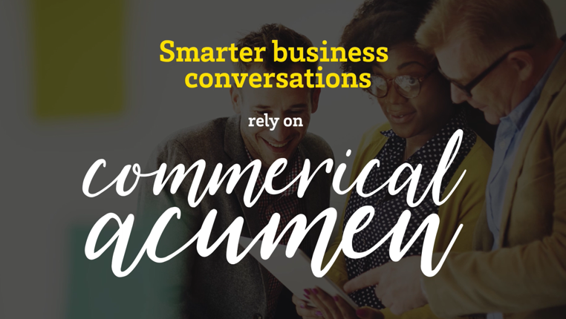
.. And it will fuel the kind of business conversations that customers value 4x more than product conversations
Notes:
Speaker Notes
This is what we need to wire in to our DNA...And we are having some smarter business conversations today.. Let’s take a look at a few examples ….

Slide 13

Efficiency
The customer’s name where we made a significant impact .. | The customer’s commercial tension/need identified through understanding THEIR business | The function we were talking with in the customer | How we developed the solution .. | A description of the McCain solution .. | The benefits for the customer .. | The learning to be shared ..
McDonald’s USA Martin Brower - Enfield | Create McDonald’s system savings. | SCAC (Supply Chain Advisory Council), McDonald’s Supply chain, Martin Brower Enfield. | We approached MB Enfield and proposed that they act as our outside storage facility, eliminating Americold and creating system savings to McDonald’s Who was involved: McCain MBU, McCain Logistics, McDonald’s Supply Chain & MB Enfield. Data/sources used: We leveraged the Havi EAS system (efficient assured supply) to calculate the average outbound cases by DC to support both MB Enfield and MB Coatesville. | MB Enfield request to continuously hold 20,000+ cases and essentially act as our outside storage facility. How the customer was engaged: Supporting / having a presence at the quarterly SCAC meetings. | System savings of $80K. Decrease in damages as the product was handled less. | Confirming the 20,000 cases were being held in inventory was challenging as MB Enfield did not have a reporting system in place to calculate & confirm. As a result, McCain logistics was managing this piece of the program.
#BeMore

Slide 14

Growth
Engagement
The customer’s name where we made a significant impact .. | The customer’s commercial tension/need identified through understanding THEIR business | The function we were talking with in the customer | How we developed the solution .. | A description of the McCain solution .. | The benefits for the customer .. | The learning to be shared ..
Aldi | With Aldi being a limited assortment customer, they wanted to carry the correct items everyday to maximize sales, while supplementing with high volume, unique items in 2 week LTO’s during the course of the year. Customer did not have category expertise in Potato Category and needed assistance in determining their Everyday Offerings as well as their LTO offerings. | Sales & Category Management | Involved: Region Manager & Sales Analyst. Data Sources: IRI Syndicated Data The team analyzed and segmented the category taking into account factors such as seasonality and incremental category sales. | McCain recommended an everyday assortment that included Shredded Hashbrowns and Steak Fries, which were not previously carried. In addition, McCain recommended that Aldi supplement their everyday assortment with additional LTO’s that included Skin-On Fries and Seasoned Spirals. | This enhanced mix of products has helped Aldi’s growth within Frozen Potatoes, which has exceeded that of the rest of the store. Aldi’s Frozen potatoes have grown over 15% and in some divisions as high as 30% year over year. | Building a relationship with our customers as category experts can pay off in win/win for both parties.
#BeMore

Slide 15

Growth
Engagement
The customer’s name where we made a significant impact .. | The customer’s commercial tension/need identified through understanding THEIR business | The function we were talking with in the customer | How we developed the solution .. | A description of the McCain solution .. | The benefits for the customer .. | The learning to be shared ..
Apex Parks Group is a privately held operating company based in Aliso Viejo, California comprised of 14 Family Entertainment Centers in multiple states, and the Big Kahuna’s water park in Destin, Florida. | Maximize revenue from the menu. | Apex Parks Purchasing and Marketing Departments | Reframing the “commercial problem” – FROM – an initial ask was for new appetizer ideas to replace the rings due to poor sales. TO – using Sales data to show the popularity (menu frequency) of onion rings. Identifying that Apex Parks is a fun center specializing in exciting experiences for the entire family, however the dining experience did not reflect the atmosphere they wanted to portray. Utilizing existing Marketing collateral to make the service of Onion Rings as exciting as the operations they are served in. | Showing Apex Parks how to make their food fun and exciting in order to generate new sales by utilizing existing marketing data and insights as well as serving ware. | Increased overall appetizer sales for Apex parks. | Dig deep for the REAL reason behind a tension point. Look at how the customer is executing their foodservice game plan and utilize the mountains of data and support McCain has to offer a solution that delivers SUSTAINABLE results.
#BeMore

Slide 16

Efficiency
The customer’s name where we made a significant impact .. | The customer’s commercial tension/need identified through understanding THEIR business | The function we were talking with in the customer | How we developed the solution .. | A description of the McCain solution .. | The benefits for the customer .. | The learning to be shared ..
Performance Food Group | Trade spend reconciliation, perceived trade differences versus PFG’s competitors. Supply chain inefficiencies. | Trade. Supply Chain Inefficiencies. | Face to face meeting. Socialized first pass BOLT Dashboards. Listened to their concerns on misappropriate trade rates. Rich Prior, Joe Kunde, Scott Barnwolt, Mike Siedel. | In progress, PFG agreed that trade reconciliation, full pallets and forecasting needs to be elevated to priority status. McCain agreed to share how we establish trade offerings in a fair and equitable manner, letting PFG understand they are appropriately priced and provided trade dollars. | Reinforces our partnership and validates the trust they have in us, the trade question has them questioning our marketplace approach. Cleaning up supply chain inefficiencies will provide more time to focus on the selling side of the business, an area where we are mutually committed. | We are building new muscles, using new tools that our customers will see value in. Cleaning things up that keep us away from doing what we do best; selling and providing customer solutions is a value that our customers demand and appreciate.
#BeMore

Slide 17

Growth
The customer’s name where we made a significant impact .. | The customer’s commercial tension/need identified through understanding THEIR business | The function we were talking with in the customer | How we developed the solution .. | A description of the McCain solution .. | The benefits for the customer .. | The learning to be shared ..
Shake Shack. Shake Shack’s US and global growth has been impressive by any measure. They’ve gone from 1 unit in 2004 to 179 in 2018. They operate 110 units in the US and another 69 across the globe. | To manage supply risk and deliver their growth ambition their need was to develop a second supplier relationship. (They started with LW). | Purchasing, supply chain & culinary. Both HQ and local stores. | After NDA’s were signed, work started on matching the benchmark product. This involved; sales, the ag team (needed to source a yellow flesh potato variety vs the commonly used white), R&D, marketing and finance. Whilst the development work was happening, we were also reinforcing our global capabilities and partnership credentials. | After three years work, several samples, factory visits and stores tests our product was approved. We have gone from 1 million pounds in 2017 to an expected volume of 12 million pounds in 2019 with one of the world’s highest profile Fast Casual accounts. A key point has been to leverage our production in one factory to: 1: Ensure product consistency as we are using a unique potato 2: make the most of our proximity to the customers biggest market…NY. | Helped them manage their risk by not having a sole supply situation, as well as speeding up their sourcing capabilities for emerging markets. | Develop a plan and work it. Cross functional communication and activation key; both internally and with the customer.
#BeMore

Slide 18

Efficiency
The customer’s name where we made a significant impact .. | The customer’s commercial tension/need identified through understanding THEIR business | The function we were talking with in the customer | How we developed the solution .. | A description of the McCain solution .. | The benefits for the customer .. | The learning to be shared ..
Gordons Food Service | Customer had developed a “Co-Creation of Value Platform” looking for ways to partner with vendors in shared cost savings. | Discussion was with The Supply Chain team at GFS corporate. Several solutions were developed by engaging McCain sales leadership, marketing, finance and supply chain. | We pulled data that showed the amount of GFS orders being bought in ‘less than full pallet configurations. Customer felt that switching to full pallets would have no real benefit to GFS. They breakdown every pallet whether full or partial. McCain did a full analysis of the GFS orders and surmised there was an opportunity for shared savings if GFS would order in full pallets. We wee also able to show them that a reduction in damages could be a secondary source of savings. | Built a tool to measure improvement and pay-out GFS. Finance, sales, Customer service, supply chain, and the deductions team all needed to be involved. GFS helped create the list of potential full pallet items and created a plan for executing the changes internally with their buyers. | * GFS was able to share this example internally and with other vendors as a model of how to co create value. They also created a revenue stream of approximately $100k annually. * McCain was able to improve our full pallets and create supply chain savings | Because we had all of the information up front and an understanding of GFS ‘s business needs we could have a more intelligent conversation.(data in advance creates a better chance for success) By physically visiting a GFS warehouse we were able to observe that all pallets are broken down (see what our customers are doing) We achieve better results when we engage many functions within McCain and with the customer.(bring in the experts!) Listening to our customer needs is crucial.
#BeMore

Slide 19

Efficiency
The customer’s name where we made a significant impact .. | The customer’s commercial tension/need identified through understanding THEIR business | The function we were talking with in the customer | How we developed the solution .. | A description of the McCain solution .. | The benefits for the customer .. | The learning to be shared ..
McGrath’s | High/Increasing labor costs Back of House | Chef, Purchasing, Founder/Owner | McGrath’s making their own cheese sticks and convinced the cost to do so was less than buying a cheese stick from McCain. Tested prepared sticks and while the customer agreed cost was less, the test failed. Dug deeper to discover servers were not supporting change, telling customers the prepared was probably cheaper, not as good. | Developed plan to overcome server objections by involving them in a cutting and activating a 2 server promotions utilizing marketing funds from our Sysco team. By engaging the front line wait staff and offering marketing support they were more receptive to the new product. | Cheese stick was a success and the customer has removed the time and cost to produce their own product. Additional benefit is the customer has agreed to run promotions on the other appetizers we sell them, meaning increased sales for McCain and increased revenue for our customer. | When faced with rejection keep digging to get to the root cause then develop action plan to over come objections.
#BeMore

Slide 20

Growth
Engagement
The customer’s name where we made a significant impact .. | The customer’s commercial tension/need identified through understanding THEIR business | The function we were talking with in the customer | How we developed the solution .. | A description of the McCain solution .. | The benefits for the customer .. | The learning to be shared ..
Sheetz Convenience Stores | Sheetz and McCain are partners on breakfast sides and snacking. Sheetz Culinary and Marketing challenged McCain in 2017 to develop new and innovative solutions to help them grow breakfast and Appetizer sales to drive traffic and sales. | McCain held in depth conversations with Sheetz Supply chain, Culinary VP and Ex. Chef, and Marketing teams. | First, we developed insights and trend presentation with McCain Marketing that we presented to Sheetz Culinary and Marketing. We initially got involved with PepsiCo sale in the Mac’n Cheetos launch with Sheetz. We also sampled McCain breakfast and snacking solutions, including FTS, Potato Skins, OREOS, and Oatmeal Bites. Sheetz Marketing and Culinary agreed to test the Mac’n Cheetos. They also kept FTS and Skins as options for Breakfast and sides menu development. | Sheetz launched Mac’n Cheetos in all Sheetz locations in 2017. Committed and sold 20,0000 cases. After review of the Mac’n Cheetos sales promotion, Sheetz decided the co-branded product did not meet their sales goals, and came back to McCain to test FTS, OREOS, and Potato Skins. We are now in test in 50 units on Potato Skins for breakfast and loaded sides application. French Toast sticks were tested and launched in all 600 units this fall. | Our emphasis on Snacking and sides complements Sheetz stated mission to sell sides and snacks “as they are our most profitable category in hot foods.” This is according to David Woodley, SR. VP of Marketing and Innovations at Sheetz. | The McCain team, including our broker partner, have developed working relationships across several Sheetz functional departments. Including Supply Chain, Purchasing, Category Management, Marketing, and Culinary which has paved the way to our success.
#BeMore

Slide 21
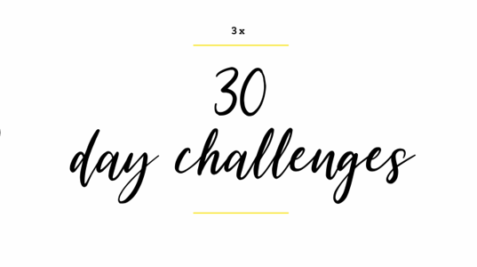
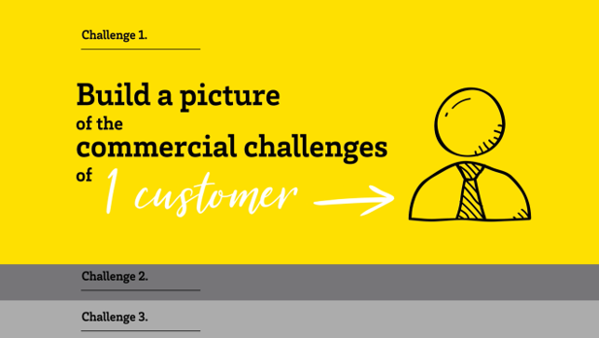
Facing into Commercial Acumen has been broken down to ..
Notes:
Speaker Notes
.. Because it’s a big subject it’s been taken in to bite size chunks.
Our first challenge is to build a picture of the commercial challenges facing 1 customer .. Building out what you’ve already started on this customer or a different one.
Let’s take look at what we’re trying to get to which will form the base of

Slide 22
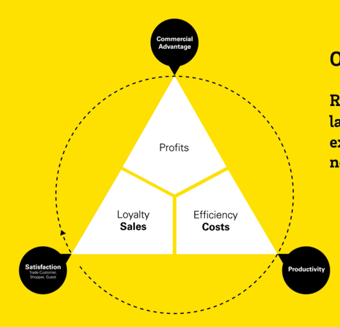
Customer:
Commercial Challenges
 | Growth | Efficiency | Engagement
Business/Corporate
Operational
McCain’s main Customer stakeholders
Metrics that Matter to the Customer (Corporately)
The big commercial stuff that the customer is working on in THEIR business allocated to whether it’s supporting growth (sales revenue), efficiency (reducing their business costs) or engagement (their corporate social responsibility).
Financial Snapshot
Financial Headlines
(trends &/or numbers)
Sales, Costs, Profits
Connects back to our core model
How the big commercial stuff filters down in the customer to their store,
outlet, depot operations.
Strategy Priorities driving the commercial challenge
How the big commercial stuff filters down to what our key contacts are being asked to focus on (and therefore what might land on McCain).
The big stuff the customer is looking to achieve as a business
(this will impact on what your customer contacts are asked to achieve).
The main metrics/kpi’s the customer is looking to influence.
E.G.
Notes:
Speaker Notes:

Slide 23
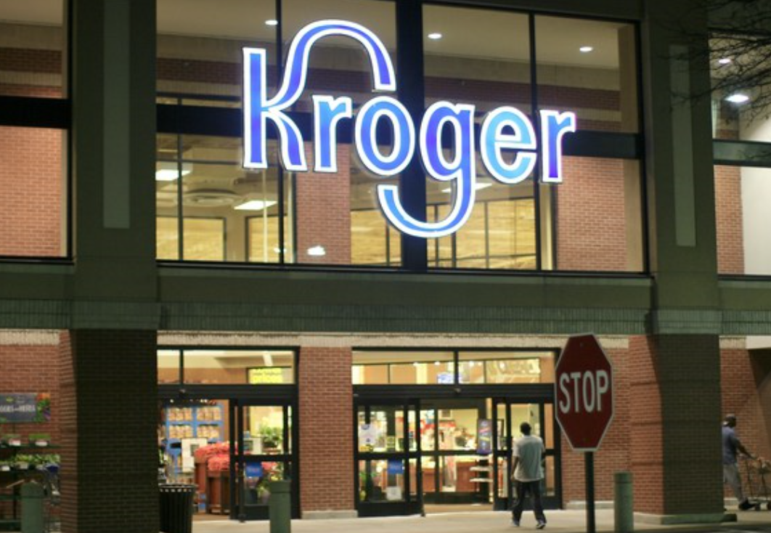
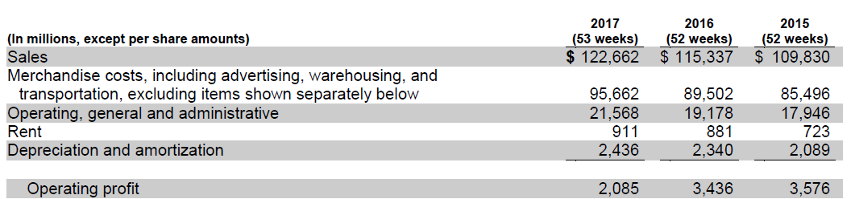
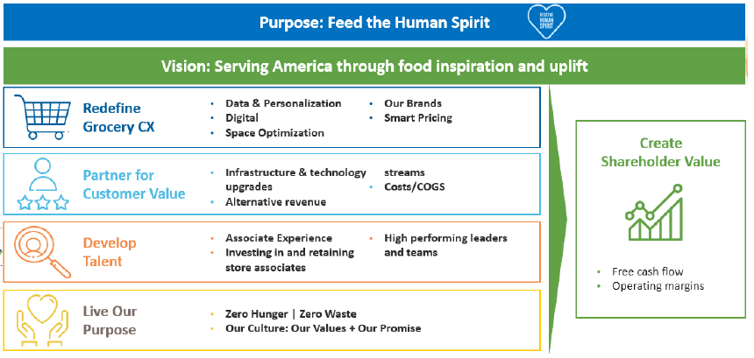
Commercial Challenges
 | Growth | Efficiency | Engagement
Business/Corporate | Year on year gains in market share. Restock Kroger: Redefine the Grocery Experience to generate $400m in profit (next 3 years). Winning in e-commerce (stop losses to Amazon). Monetizing services/products e.g. Kroger Precision Marketing or Turkey Hill Ice Cream as a revenue stream. Offset declines in petrol/fuel price changes with Grocery sales. Expand Restaurant concepts (penetrate more eating occasions). | Eliminate waste by 2025. Manage cost reductions through “Make or Buy” decisions. Cost efficiently expand partnerships e.g. Ocado. Improve cost to serve primarily through stores. | Improve the environmental footprint. Deliver Responsible Sourcing targets by 2020. Support to operationalise eating trends and make accessible e.g. Meal Kits. Support corporate CSR initiatives like Zero Hunger, Help for Heroes.
Operational | Increases like for like store sales. | Eliminating increased warehousing, transportation and shrink costs. Reducing store operating costs.
McCain’s main Customer stakeholders | Growing category share. Increase frozen average basket spend. Generate supplier income for Precision Marketing. | Reducing frozen/chilled operational costs. Improve on shelf availability from x to y. | Contributing to the corporate environmental agenda.
Metrics that Matter to the Customer (Corporately) | LFL store growth excl. petrol (+0.9% in 2017). Digital revenue (+90% in 2017). | Product cost deflation (+0.8% in 2017). Managing operating, general and admin costs (increased per $ sold n 2017). | Shopper satisfaction scores (stores/e-comm). Guest satisfaction (restaurant concepts).
 | Free cash flow (as an investment fund – doubled to $800m in 2017). Shareholder dividends. Gross margin (declined in 2017 because of increased investment in price). Improvements in operating margin. On shelf availability.
Financial Snapshot
Summary: Increases in costs outpacing sales growth which is negatively impacting operating profit
THEREFORE .. Likely to want to maintain sales growth BUT get more efficient to recover profit.
Strategy Priorities driving the commercial challenge
Notes:
Speaker Notes:

Slide 24

The steps we need to walk through …
Capture what we know now about the customers commercial challenges.
Hit external sources: www to search and find out more AND their outlets, depots, stores.
Identify knowledge gaps and identify who to have a conversation with to close them.
Get your “high gain” questions ready. Use them and actively listen.
Build out your Challenge Tool and look for any connectivity to the requests you’ve had from the customer &/or the actions you see them taking.
Socialize with completed tools with your buddy and the team.
Notes:
Speaker Notes
-

Slide 25
Customer:
Commercial Challenges
Financial Snapshot
 | Growth | Efficiency | Engagement
Business/Corporate
Operational
McCain’s main Customer stakeholders
Metrics that Matter to the Customer (Corporately)
Summary:
XX
Strategy Priorities driving the commercial challenge
Notes:
Speaker Notes:
Let’s do Step 1.
Buddy up and work on it together for just c 5-10 mins using each other to check first thinking. Capture what we know today about the customer’s commercial challenges ….
OQ: How have you got on? What’s difficult?

Slide 26

Let’s see if we can generate 15 ideas about how to get a better understanding using readily available sources.
Notes:
Speaker Notes
Preparing for Step 2 …
Brainstorm ideas about where and how to expand our understanding using external sources…
Get someone to capture and share them after the session.
Give me 2 actions each you are committed to completing.

Slide 27
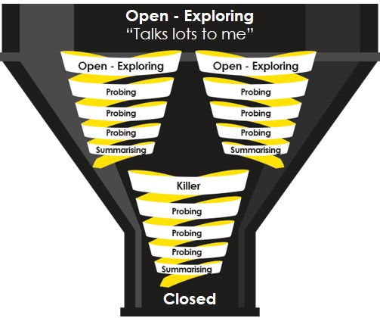
Who might you want to talk to in the customer?
If you only had 3 open questions to get that person talking, what would they be?
Notes:
Speaker Notes
Preparing for Step 4 ….
OQ: Who would you want to talk to? Do we know them? Do we need an introduction and if so who could give you one?
OQ: If you only had 3 open questions to get that person talking, what would they be?
Remember that great questions warrant great listening!

Slide 28
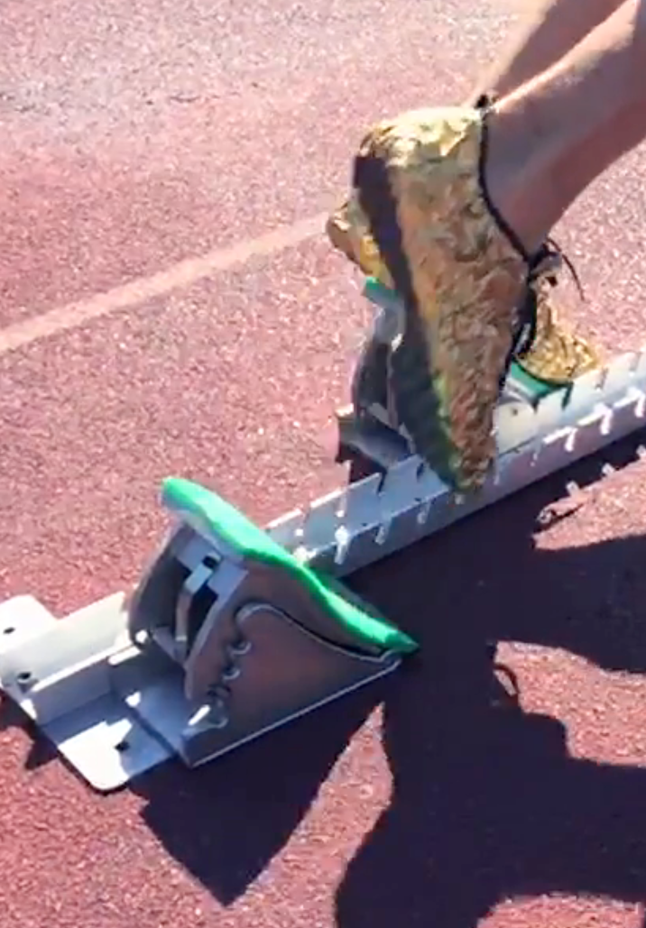
You’re out the blocks, let’s go …
Notes:
Speaker Notes
- We’re off …. Let’s agree the check in date to share with buddies and socialize.

